Slide 1
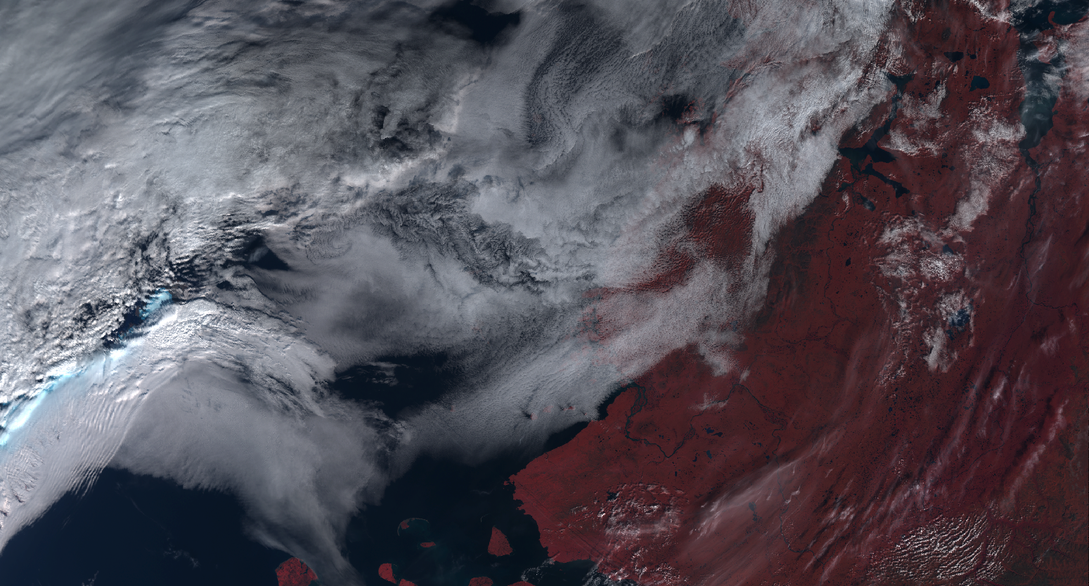
Material for Meeting
14th January 2019

Slide 2
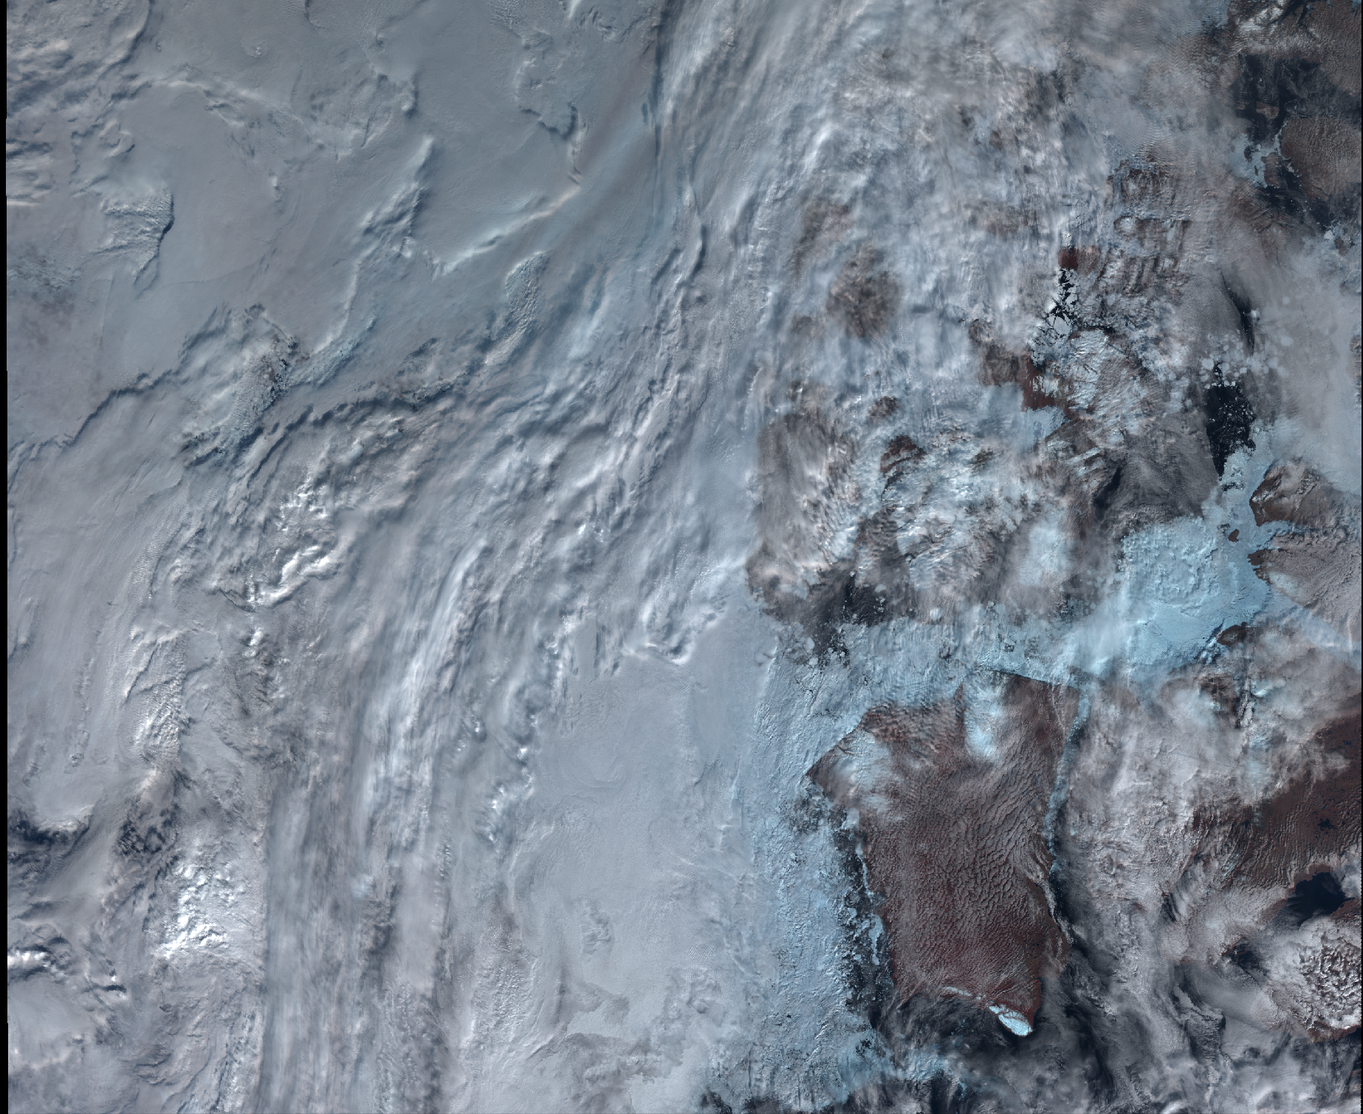
Summary
Aim
Data
Example plots
Accuracy
Application speed
Future directions
Housekeeping

Slide 3
1. Aim
Identify clouds in satellite images between 60 and 90° absolute latitude using machine learning.
Artificial Neural Networks (ANN)
Deep Feed Forward Network (FNN) or Multi-Layer Perceptron (MLP)
Making predictions on SLSTR images (Sentinel 3A and B)
Training the model using CALIOP data (CALIPSO)

Slide 4
2. Data processing
Calipso data is downloaded from https://search.earthdata.nasa.gov/ ~16GB per month (day files only).
Matches are found using ESA queries ~ 1 hour per month of data. The matches are stored in .txt format.
The identified SLSTR files are downloaded. This is the slowest part of the process ~ 7 hours
Once all files are downloaded, the collocation is performed on the paired files and the relevant pixels are stored. This takes ~ 1 hour and produces the output .pkl files.

Slide 5
https://docs.google.com/spreadsheets/d/1W3gyqzpbKeNRWvtOrYsDbg2UzzVLfw-t74esUQ_12GU/edit#gid=0
2.8 million collocated pixels recorded with 33 variables stored after > 2 TB processed
764 MB pandas dataframe
30 parameters inputs : 9 SLSTR channels, longitude, latitude, solar zenith angle, satellite zenith angle, surface types (one hot encoded)

Slide 6
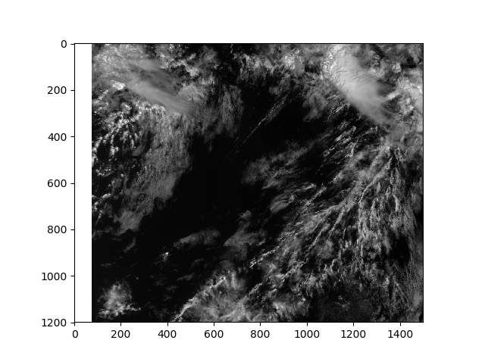
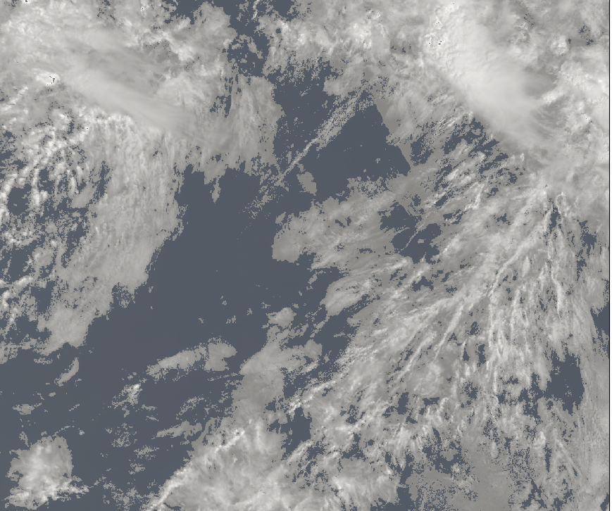
3. Example plots
Left: Generated mask
Right: S1_an channel data

Slide 7
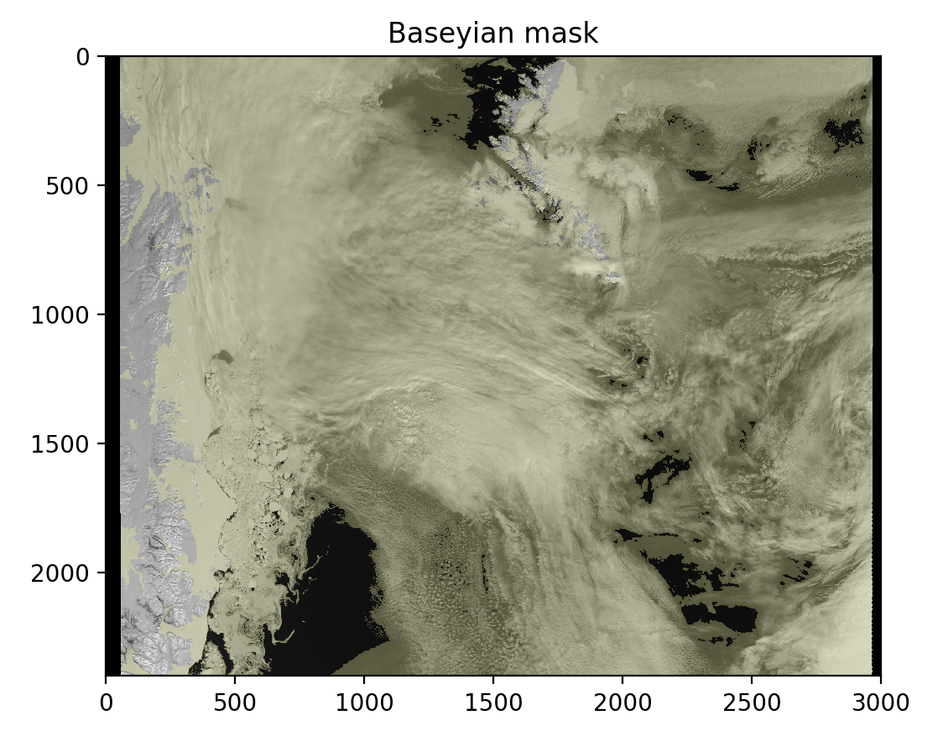
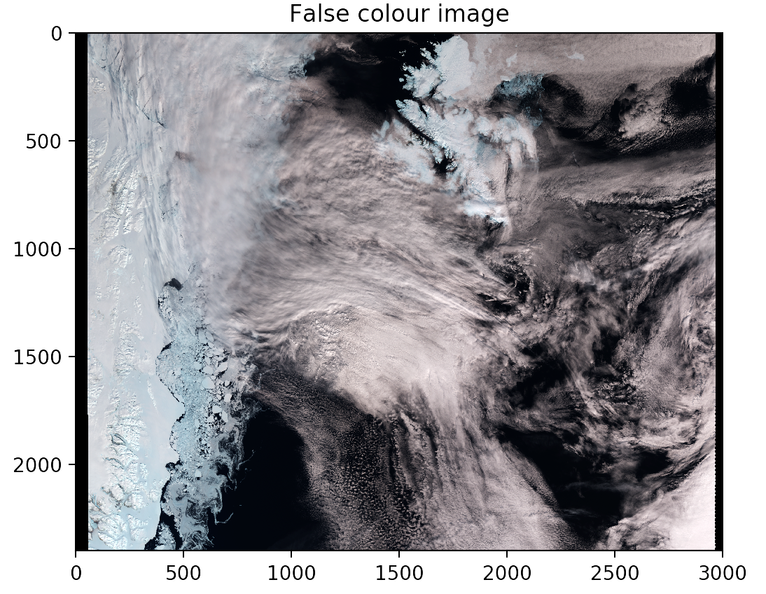
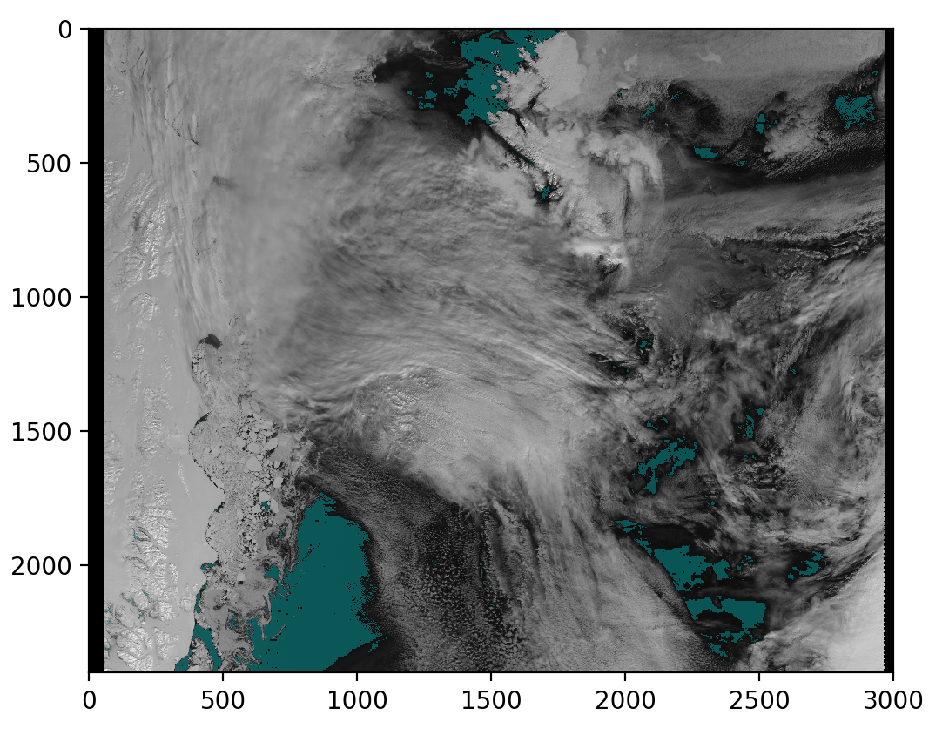
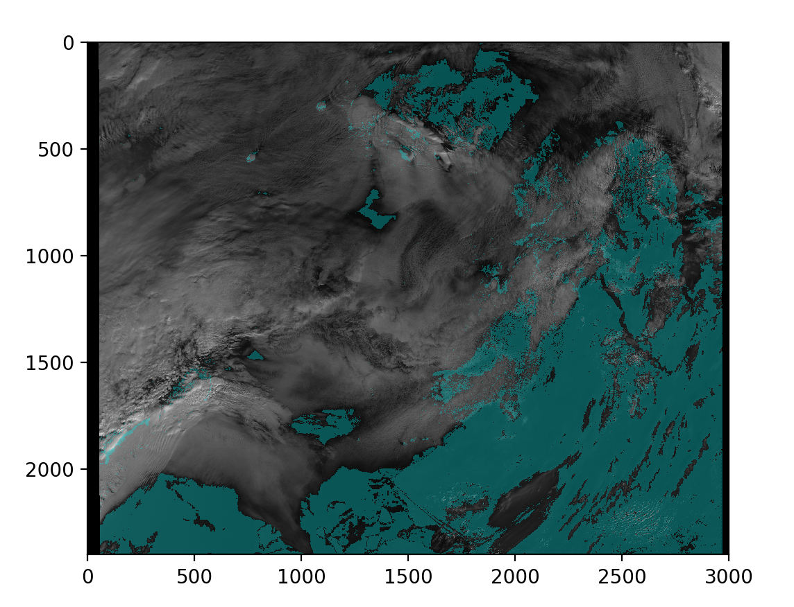
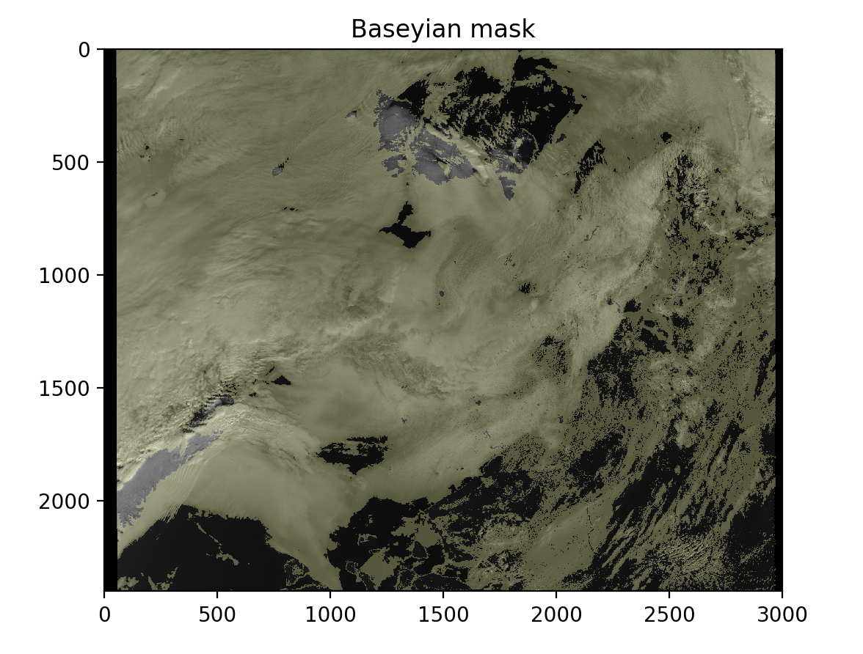
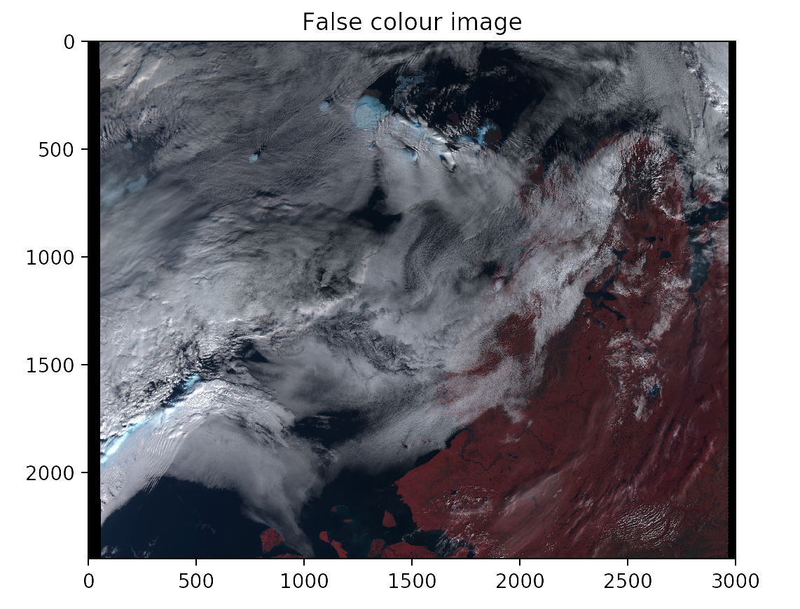

Slide 8
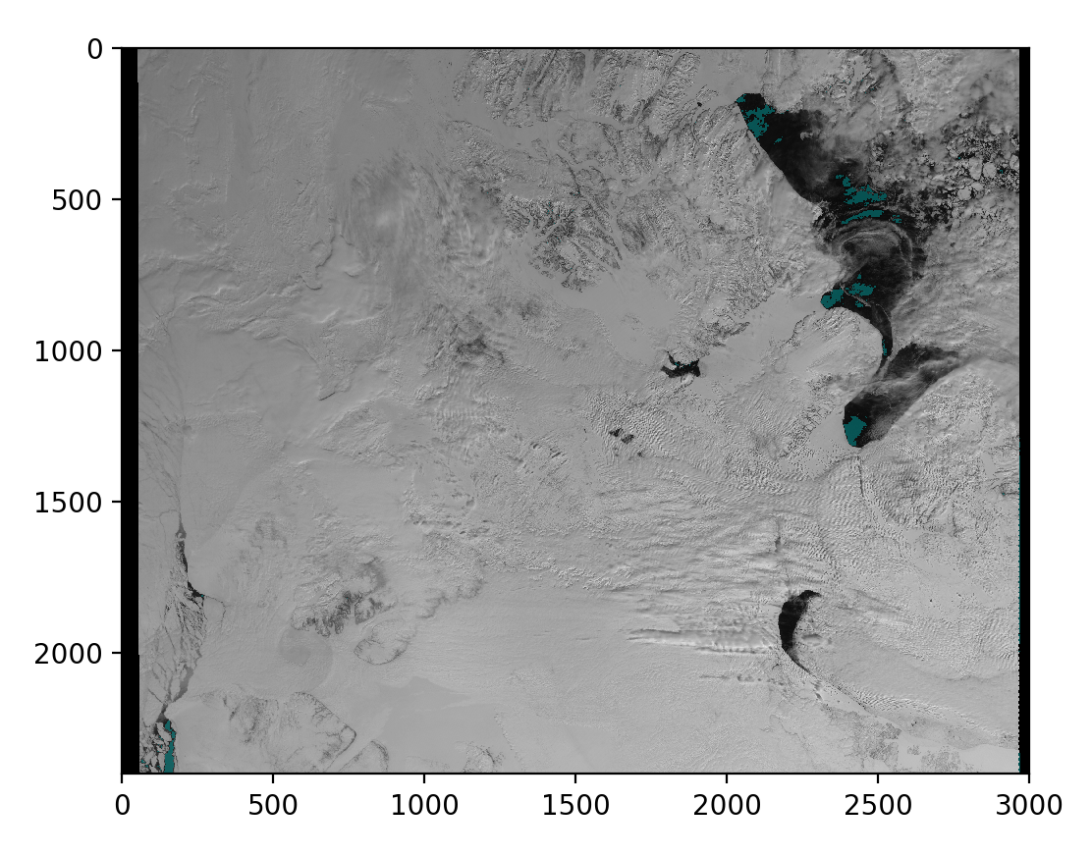
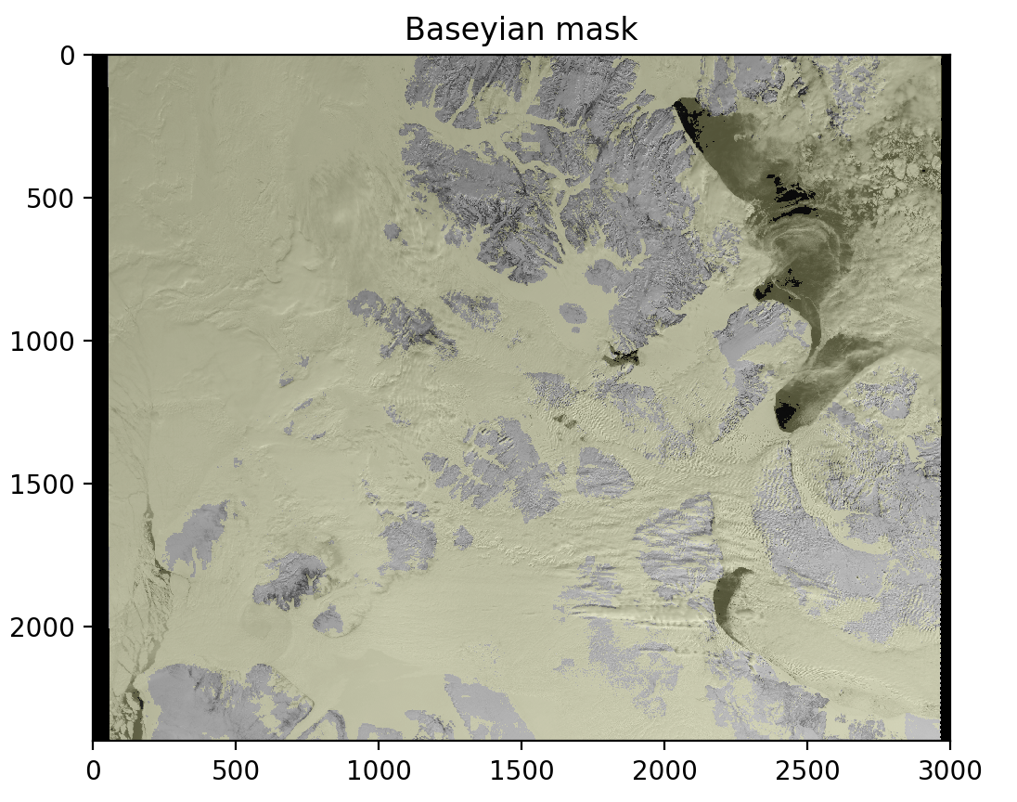
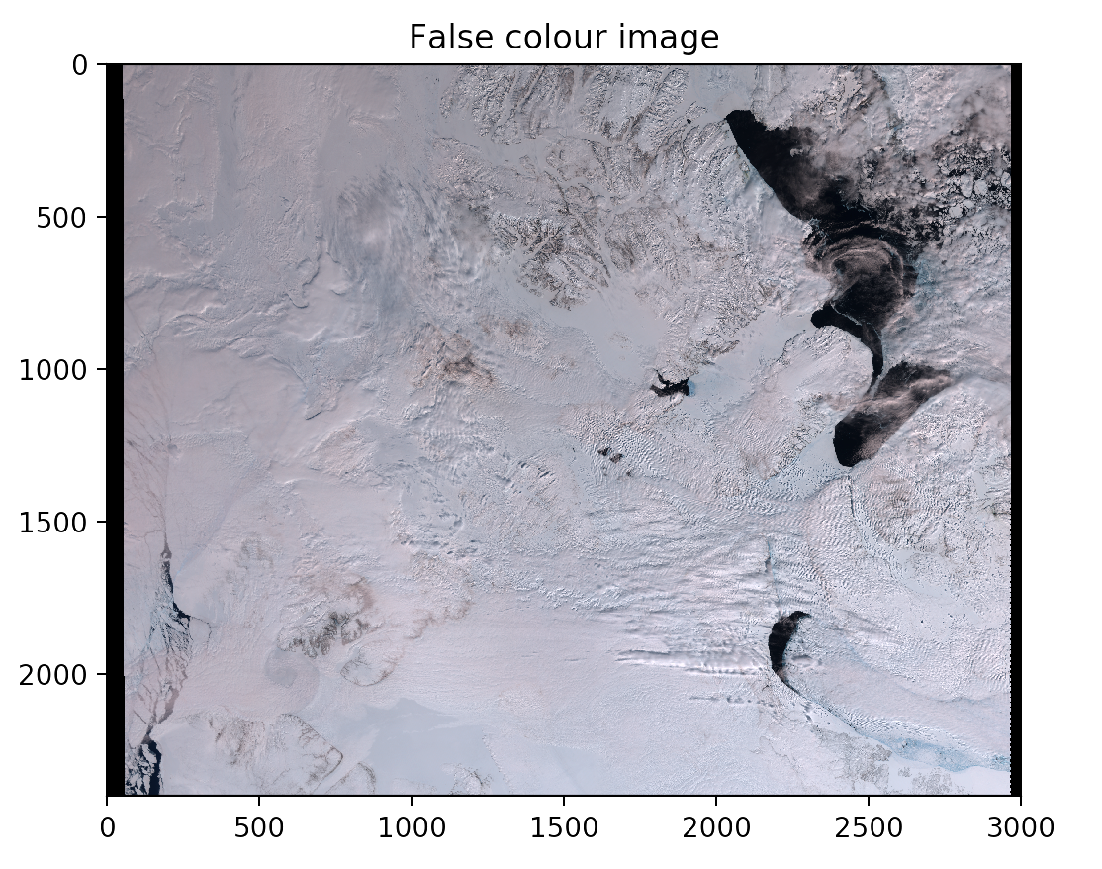
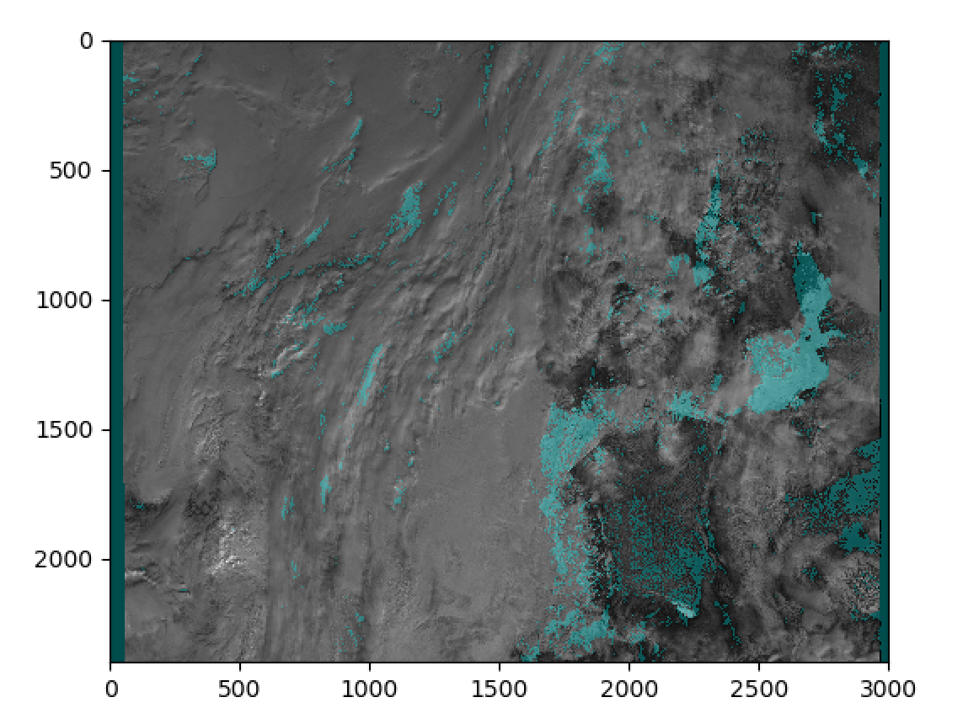
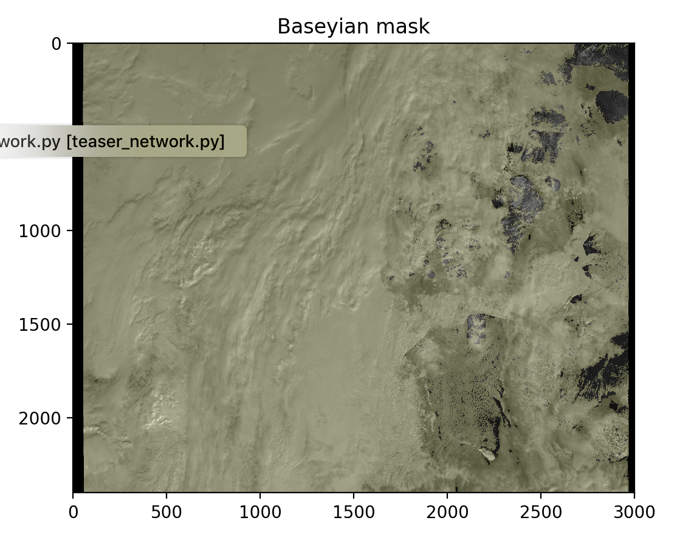
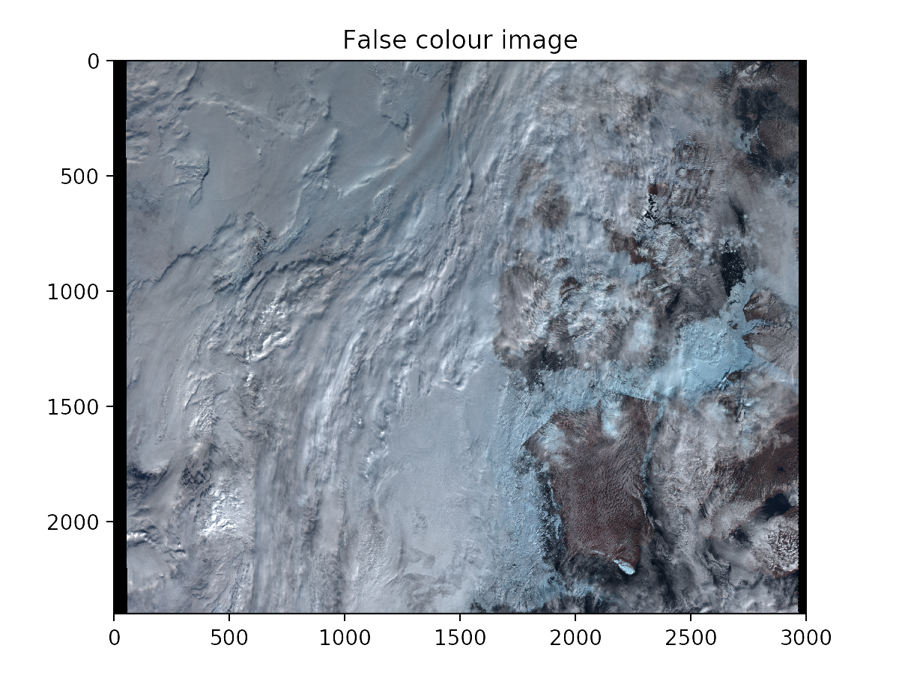

Slide 9
4. Accuracy
Hyperparameters
We have found that layers with the same number units (32) work best
Number of layers above 5 make little difference
Dropout of 0.8 gives the best accuracy
The in-built ADAM minimiser also works best (this one is also used at DeepMind)
Minimisation cross-categorical entropy
Model accuracy approx. 80%, no dependence on satellite zenith angle, time difference (within 10 minutes). Accuracy mean plummets and variance increases when noise data is added.
Estimate the reproducibility of the model results using network ensembles

Slide 10
6. Application speed
Training a model take approx. 3 minutes
Applying a mask to one image takes under 10s
7. Future directions
Create a Convolutional Neural Network (CNN) account
Add more ancillary data as inputs
Create a network ensemble

Slide 11
8. Housekeeping
We are free next term:
Monday morning
Tuesday between 2 and 5pm
Wednesday (all day except 11 to 12 pm)
Thursday after 2pm
Friday morning
Last meeting with Prof Egede Tuesday at 2pm

